Slide 1
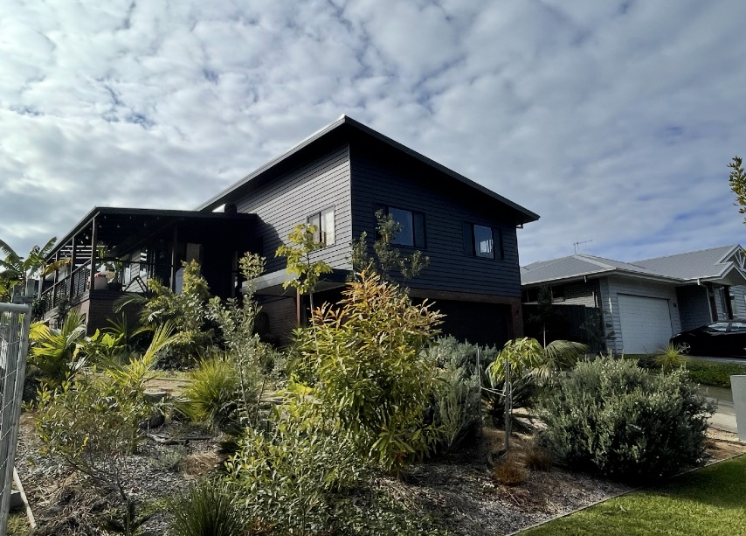
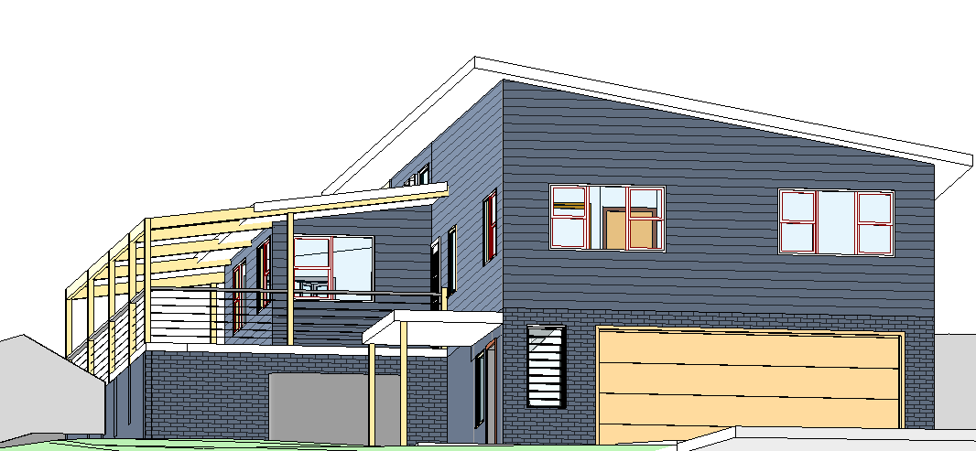
Improve Productivity using OpenBIM IFC for BASIX compliance
Online Meeting
14th January 2026
John Mitchell: CQR
Scott Beazley: GeometryGym
v1

Slide 2
Digital possibilities for efficiency and productivity gain
An example from housing in NSW
NCC structure
NSW variations
Section H6 Energy Efficiency for residential buildings – BASIX (Building Sustainability Index)
Current BASIX input method
A large amount of data is required to populate the website data fields manually with keyboard and mouse
Project proof of concept
Use project information contained in digital 3D design file to automate the population of data fields
Embed data within the model objects and align to BASIX data fields
Verification method to check model data

Slide 3
Trust of digital information from 3D models to:
Contain Project data
Achieve Compliance
Reduce Risk
Avoid Duplication
Eliminate Inconsistency
Eliminate effort
Architect\ Designer
Design components
Object data
Product supplier
Component data
Regulatory Compliance
NCC\BCA\local requirements
Project data
Design components
Object data
Regulatory Assessment
Specific project data
NCC\BCA\local requirements
Design components
Object data

Slide 4
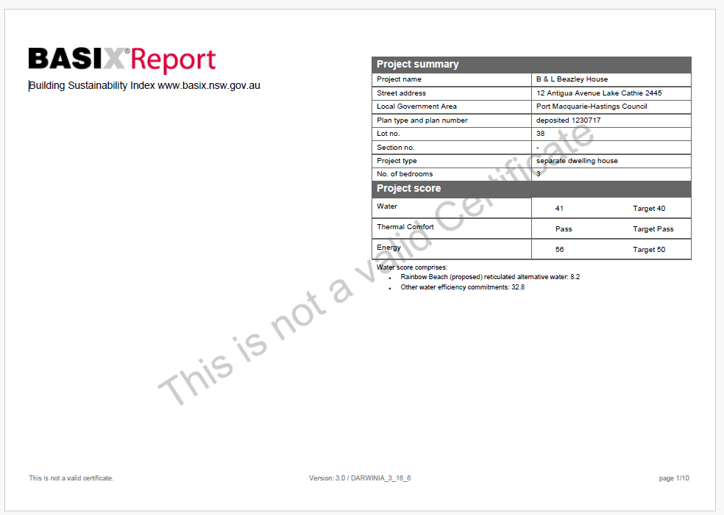
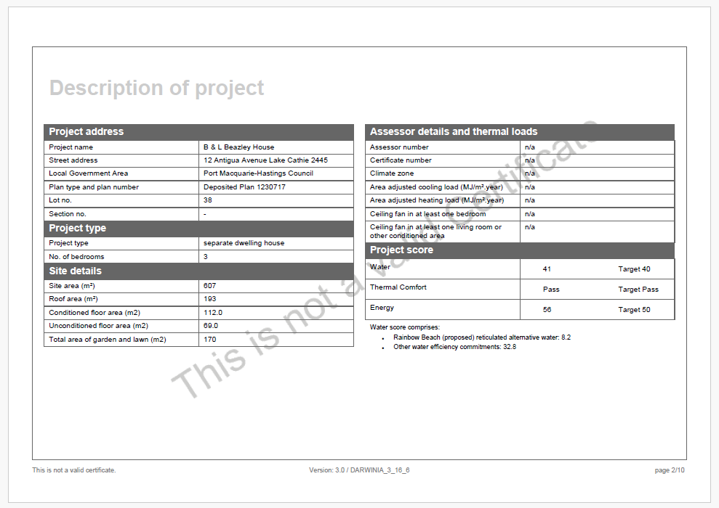
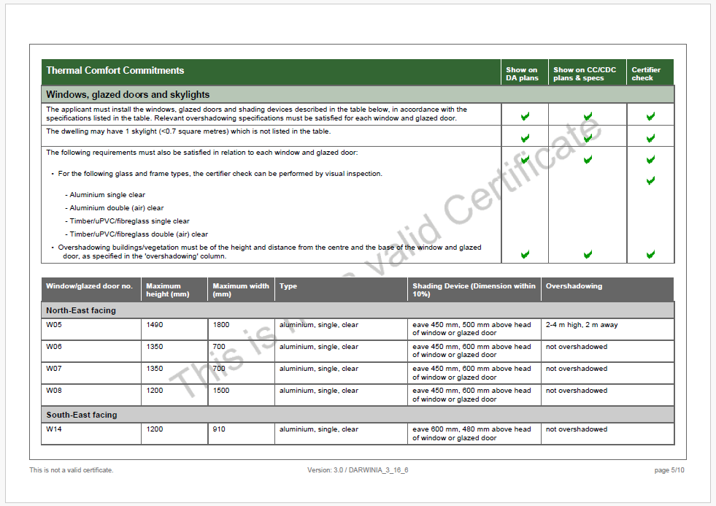

Slide 5

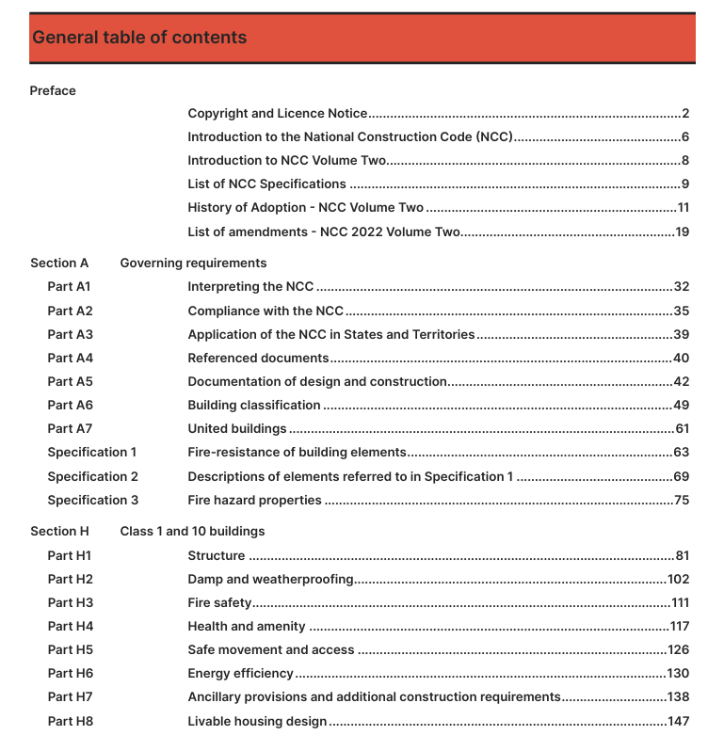

Slide 6
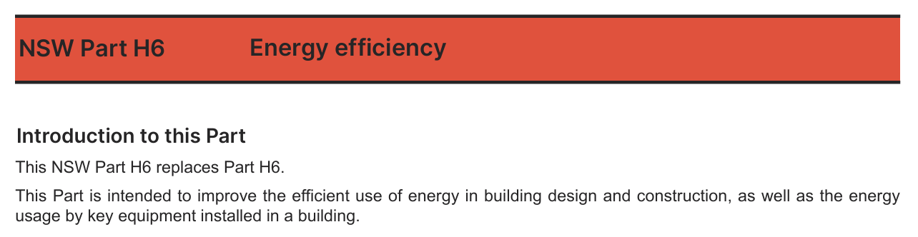
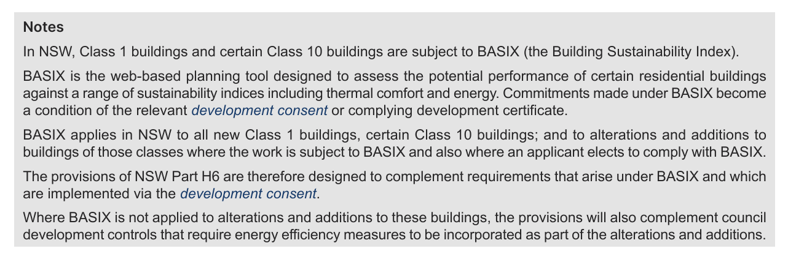

Slide 7
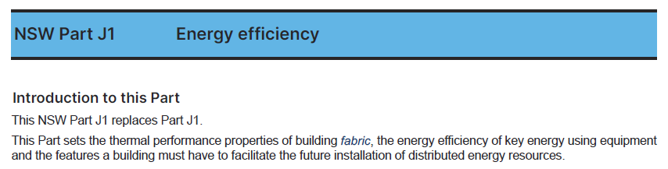
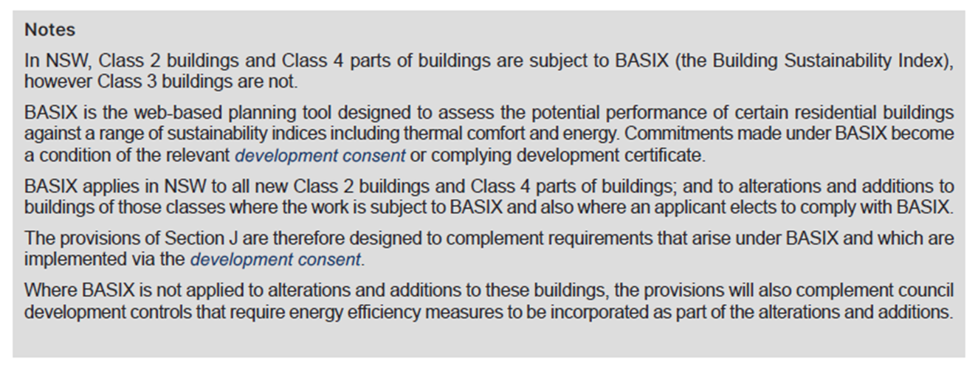

Slide 8
NCC structure: NSW variation
Section H & J for residential buildings
This includes BASIX
Online submission
Aim to achieve minimal for water usage, energy consumption and maximise thermal comfort etc.
Once achieve minimum level then can generate a BASIX Certificate from website
What data does the BASIX require?
Building and site areas
Fabric specifications
Appliance type
Window areas, glazing specification, orientation, shading
Information already contained in 3D models

Slide 9
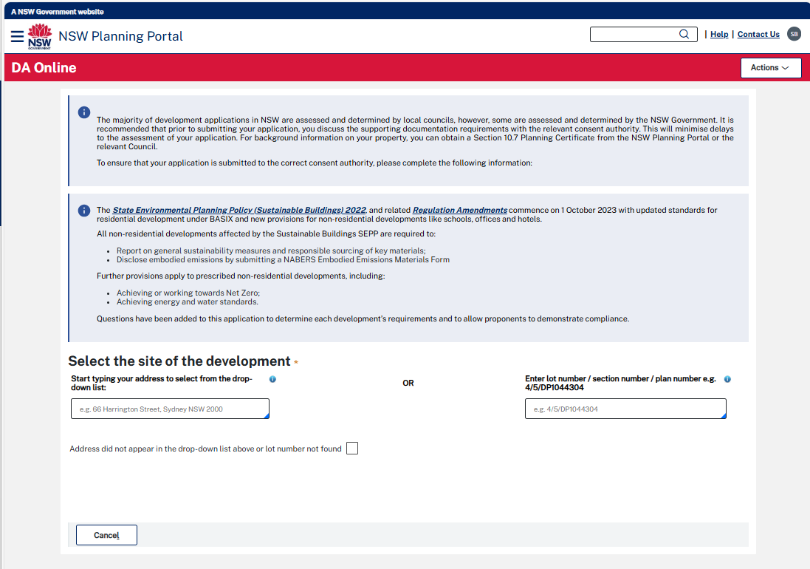
Relevance for other code compliance uses
Parts of the puzzle
Defined

Slide 10
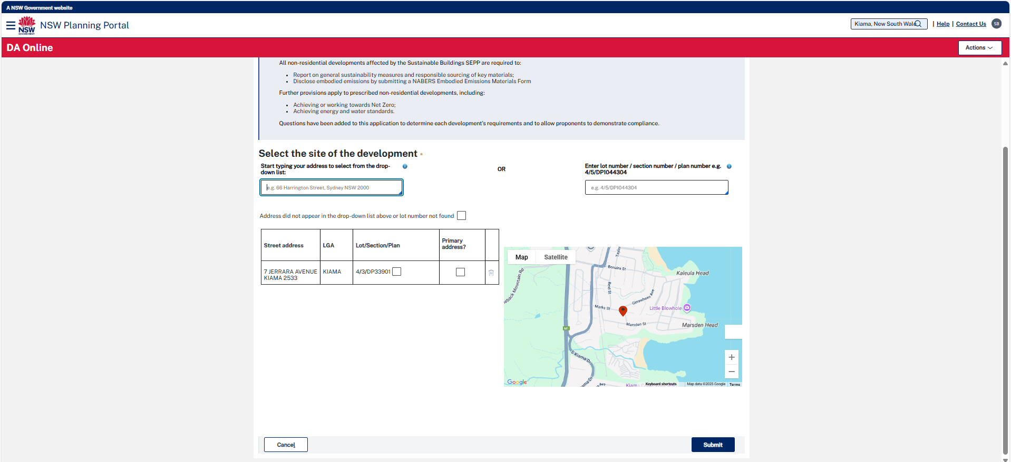

Slide 11
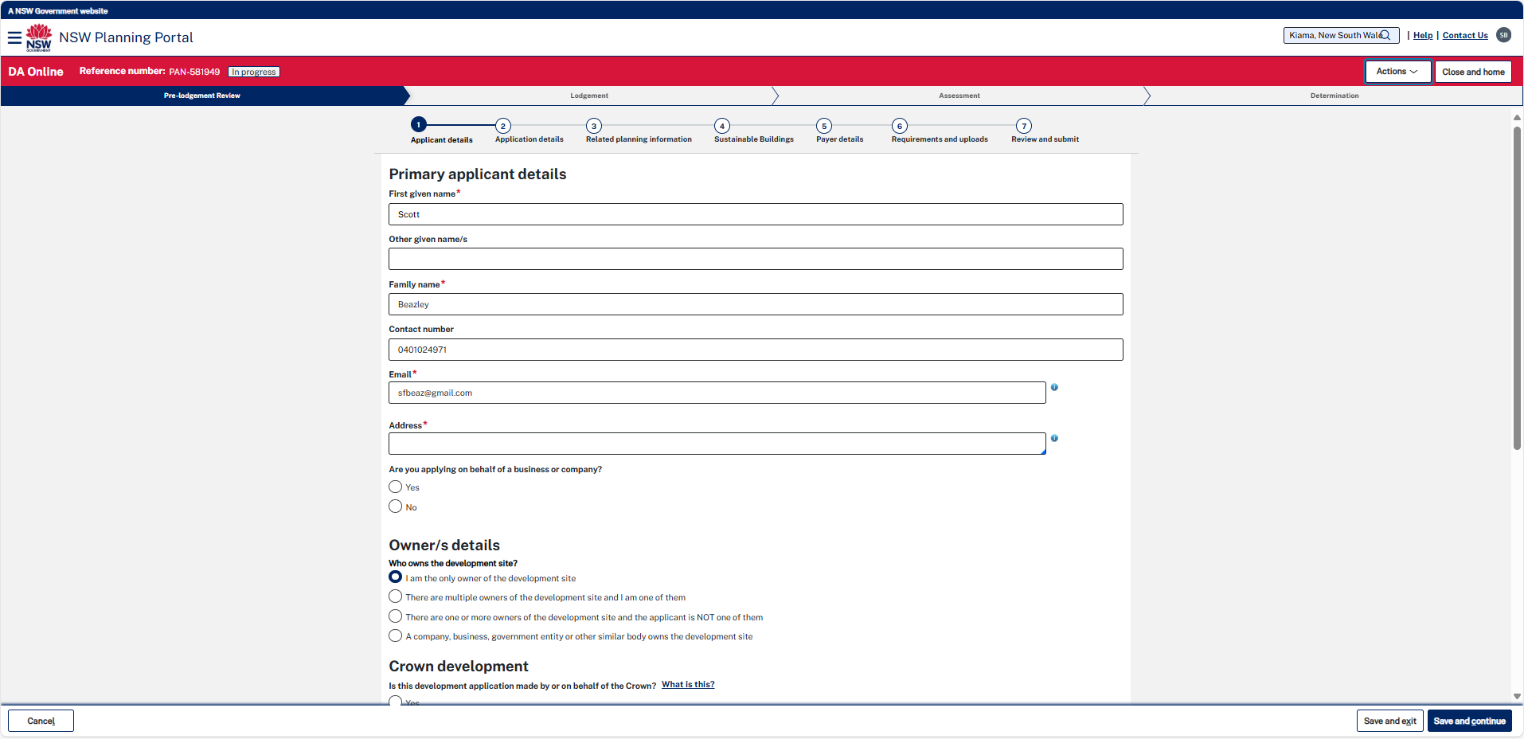
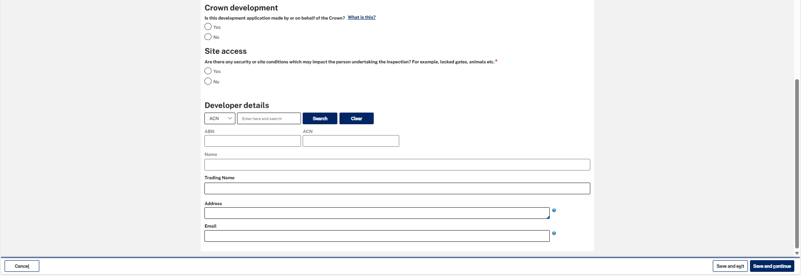

Slide 12
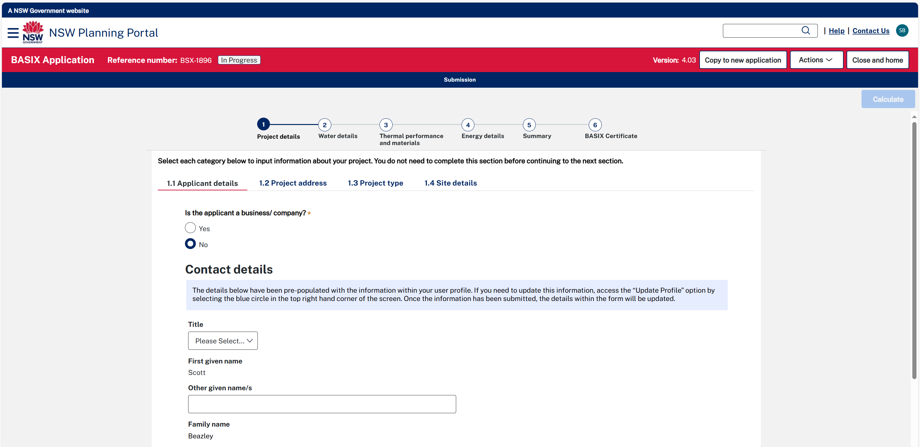

Slide 13
Improving Productivity with Open BIM, IFC and IDS
Submission of a BASIX assessment is currently a complex web-based task requiring manually filling in over 200 information items, requiring tedious preparation, duplication of tasks etc.
We demonstrate IDS - the new way of validating information content in a building model.
IDS offers a simpler process,
integration with the BIM authoring process and
actually provides more accurate data to assess the performance requirements of BASIX.
The talk will explain the role of IDS and provide a demonstration of an actual residential building using a prototype developed by Dion Moult.

Slide 14
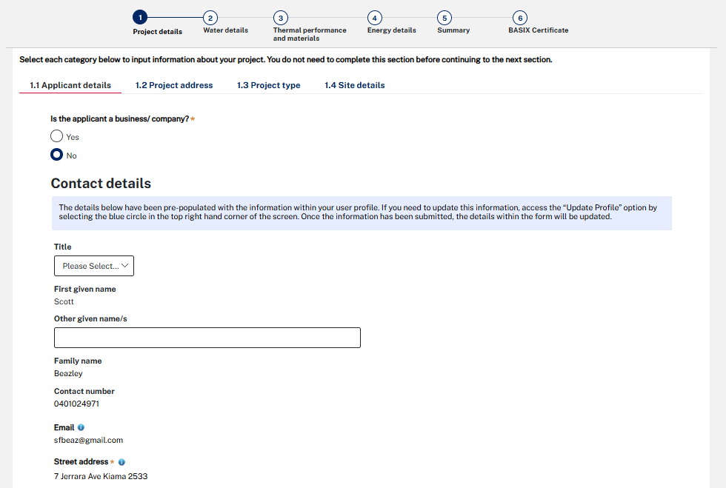
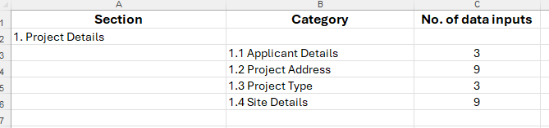
Sample of required BASIX data
Submission of a BASIX assessment is currently via a web-based task requiring manually entry

Slide 15
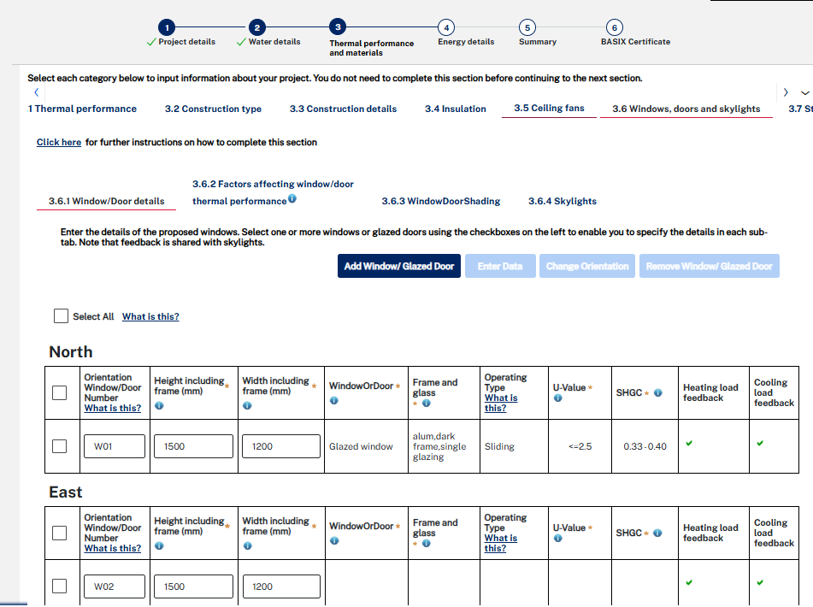
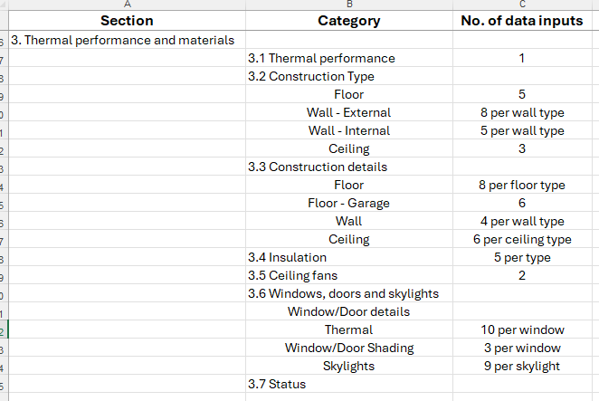
Sample of required BASIX data
Submission of a BASIX assessment is currently a complex web-based task requiring manually filling

Slide 16
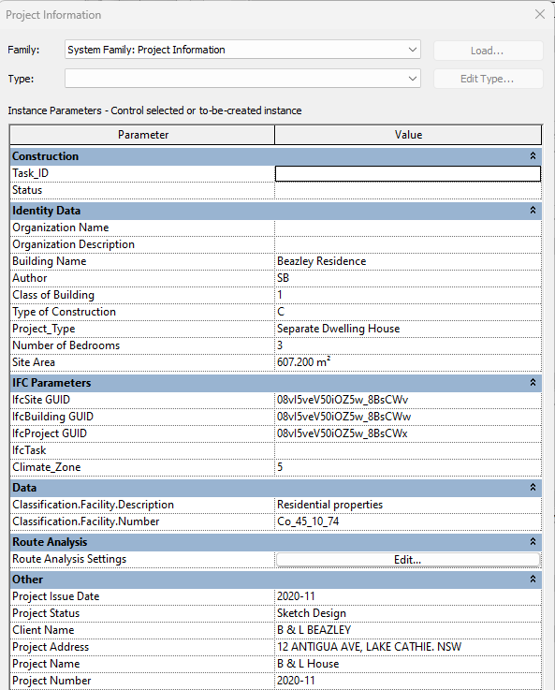
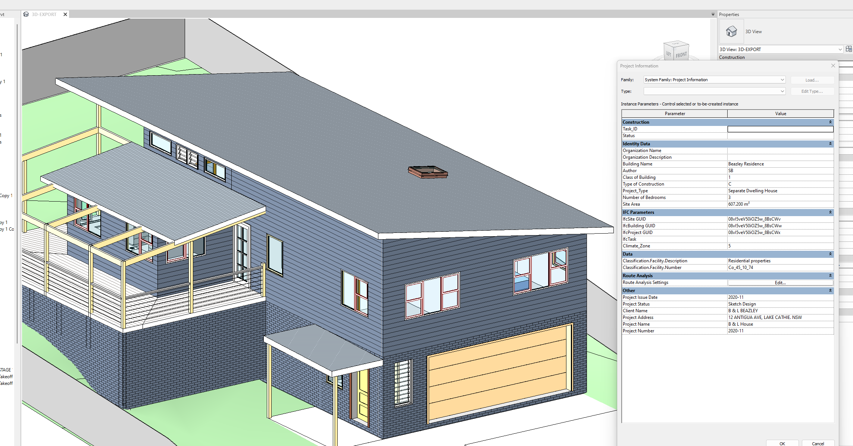
Data within 3D models
Revit 3D model

Slide 17
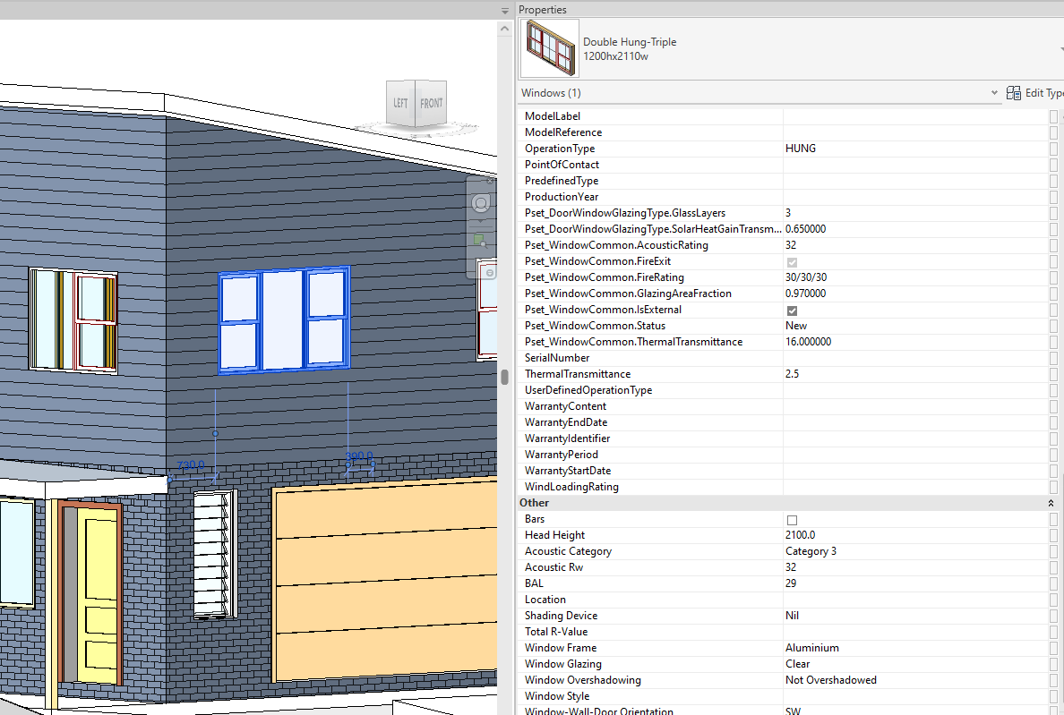
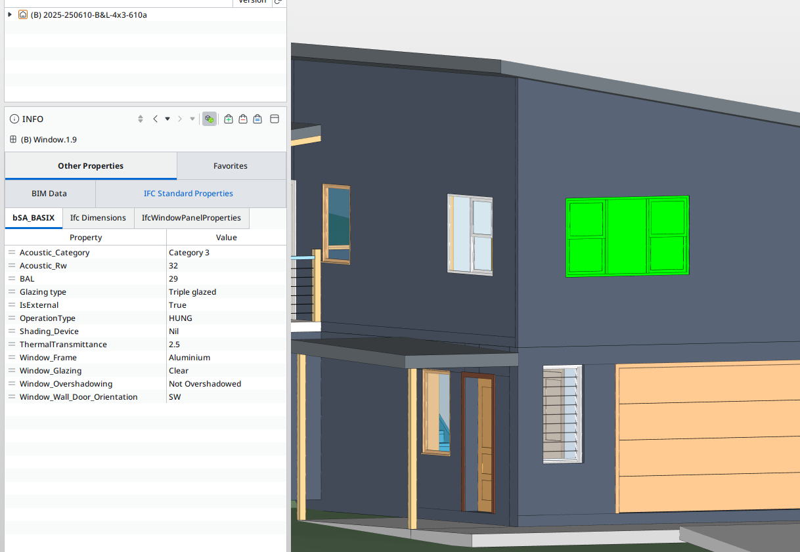
Data within 3D objects
Revit 3D model
IFC 3D model in Solibri Model Checker

Slide 18
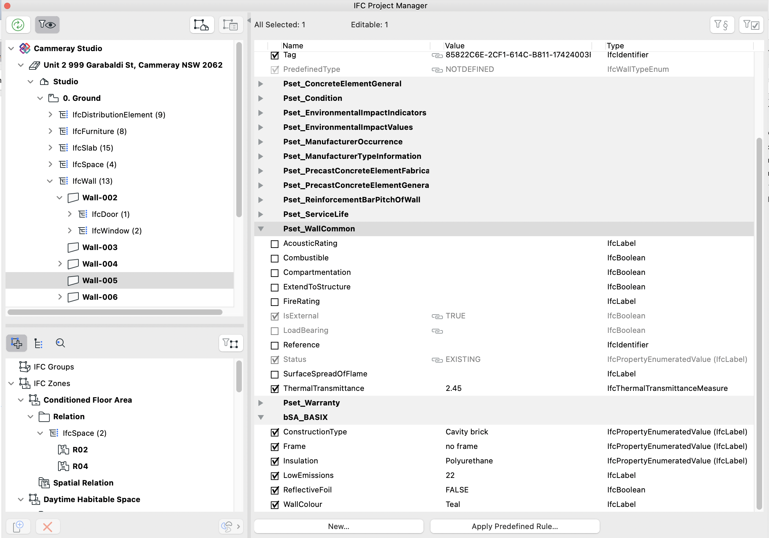
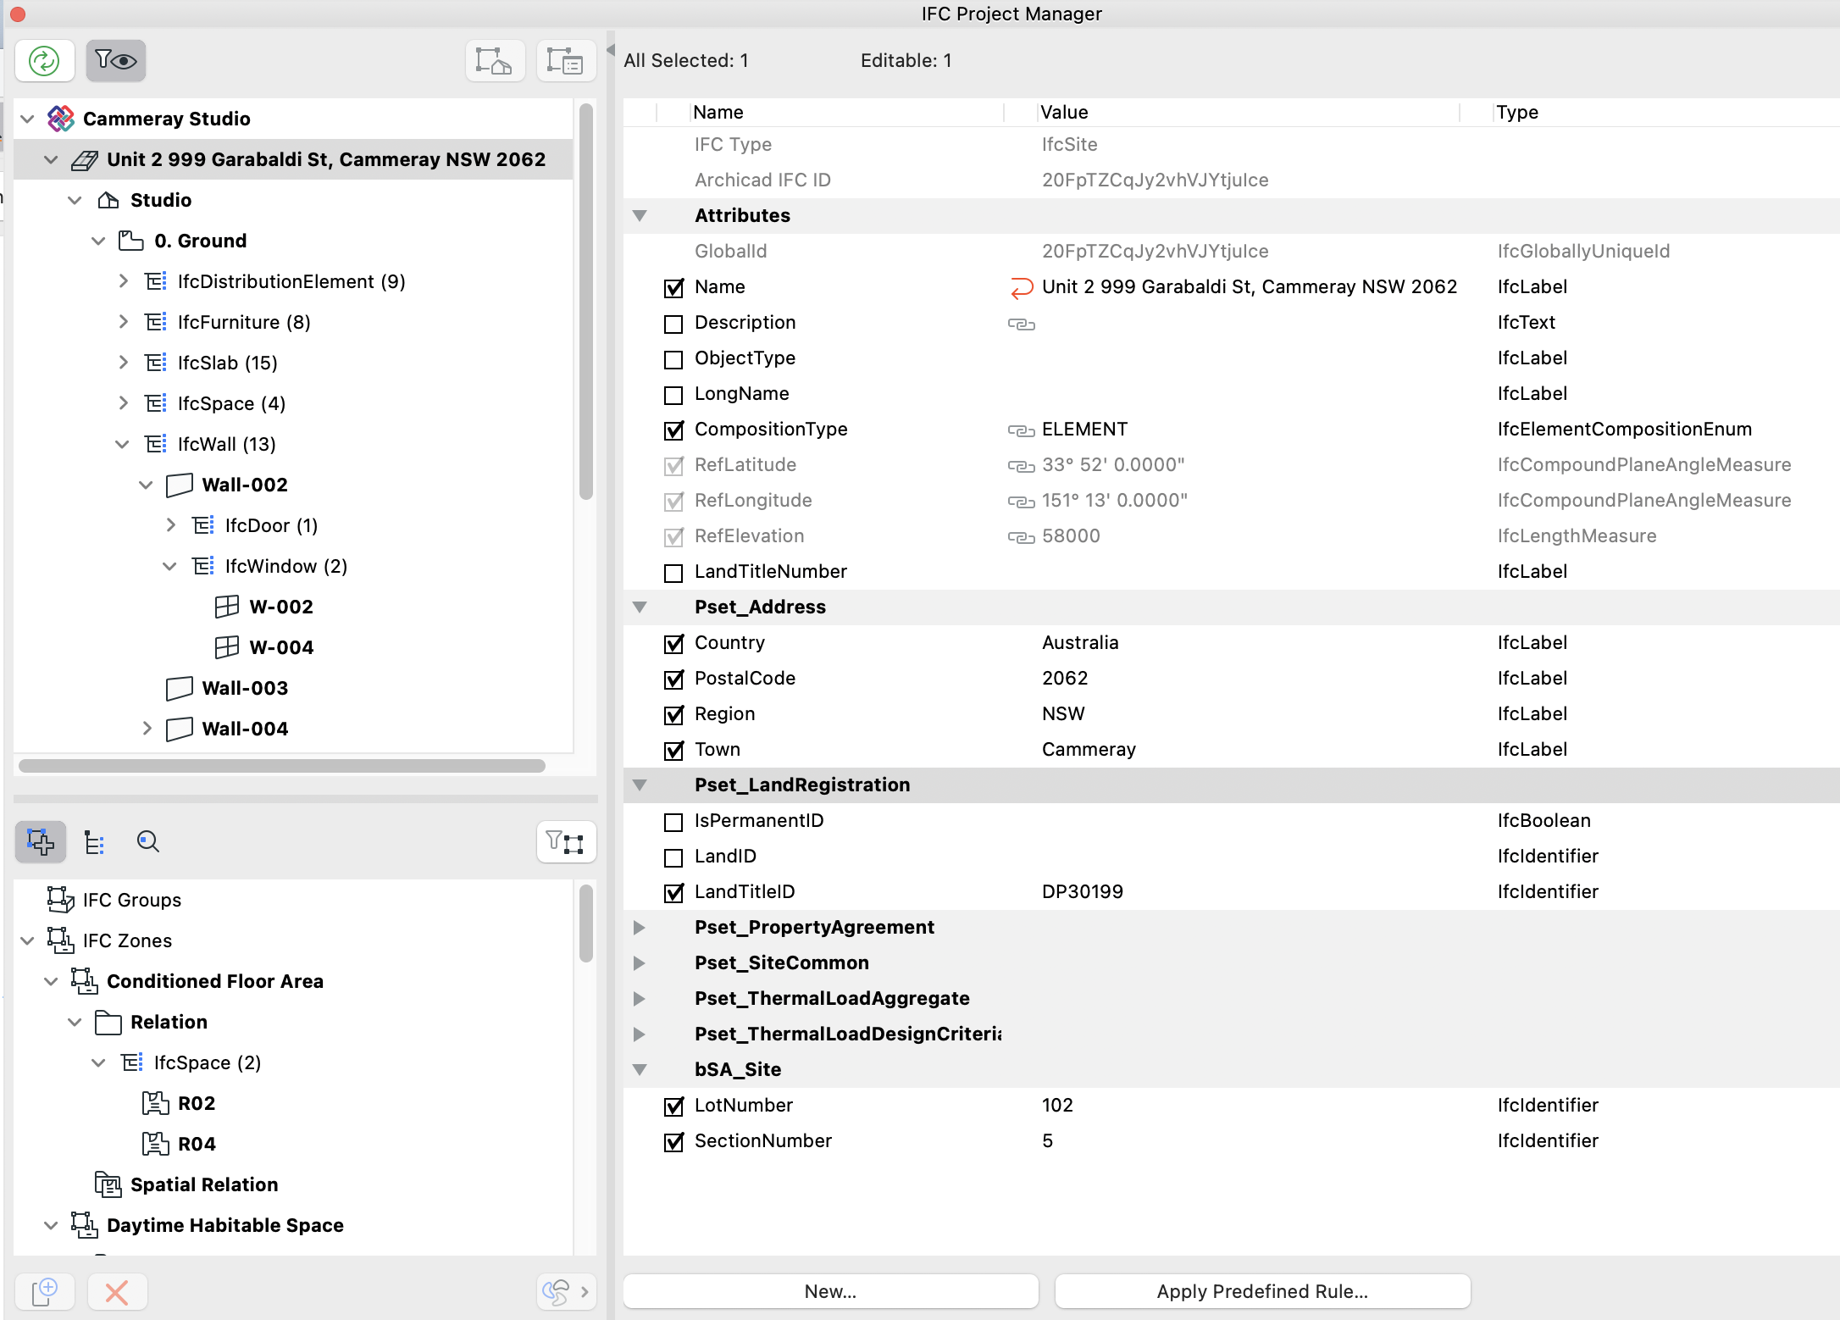
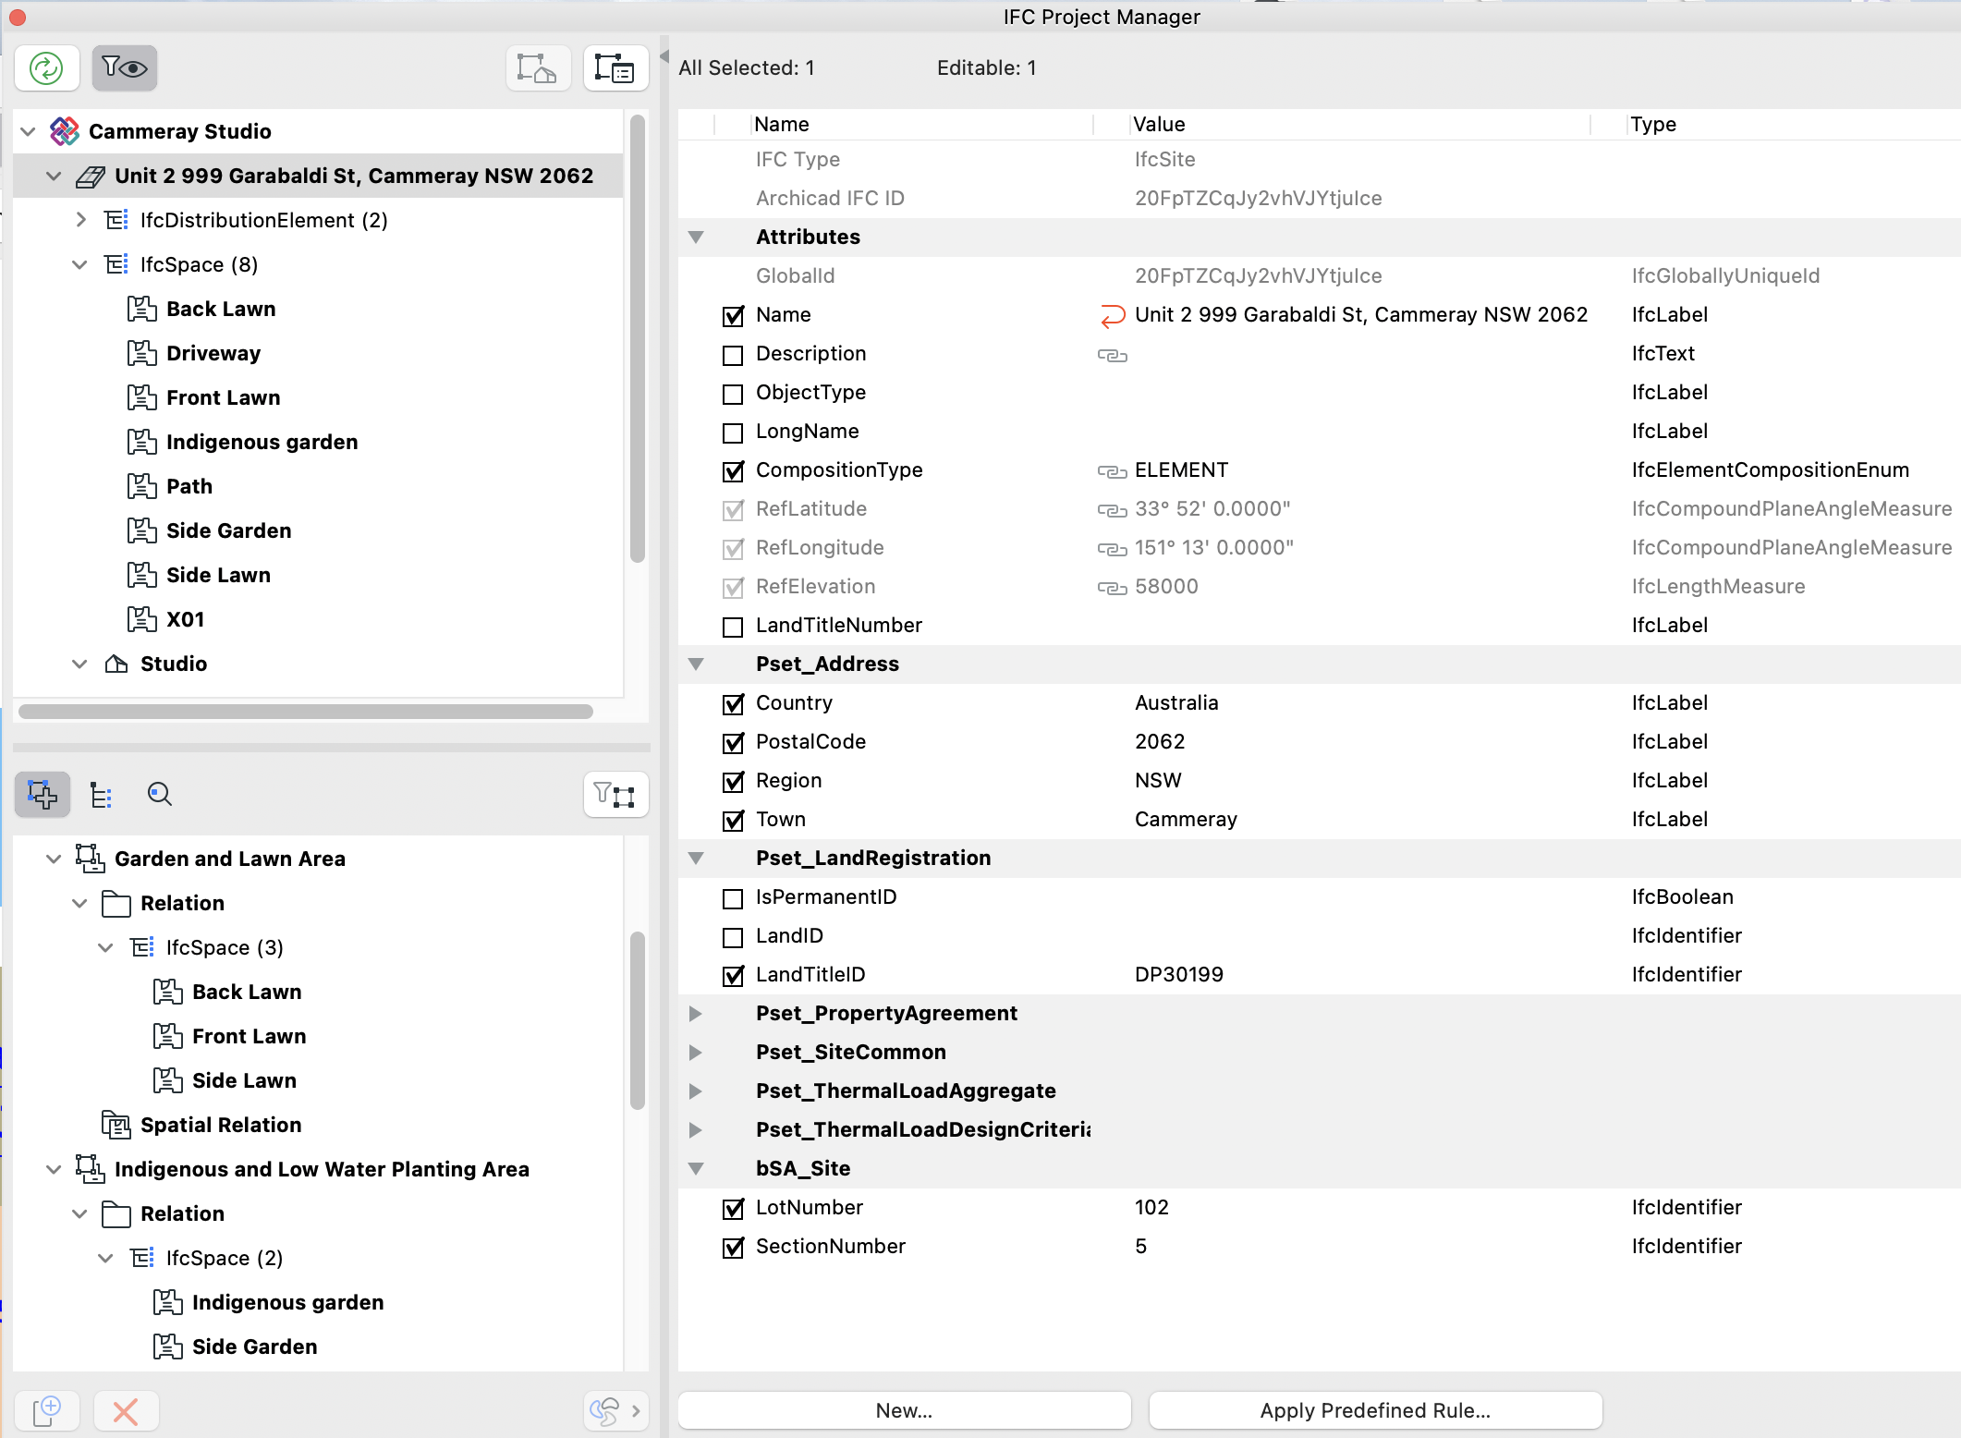
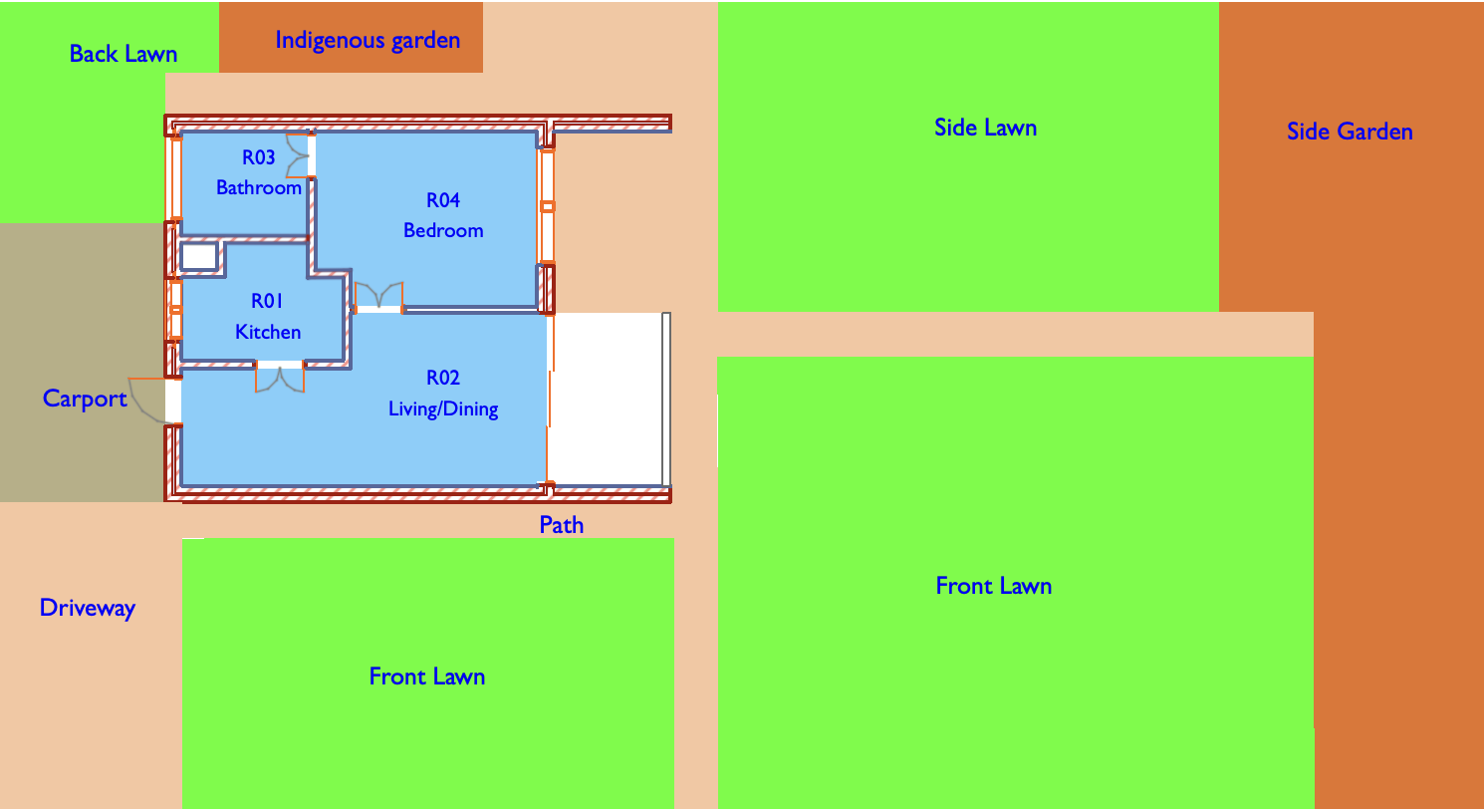
specifying the IFC data…in ArchiCAD model
Landscape Plan

Slide 19
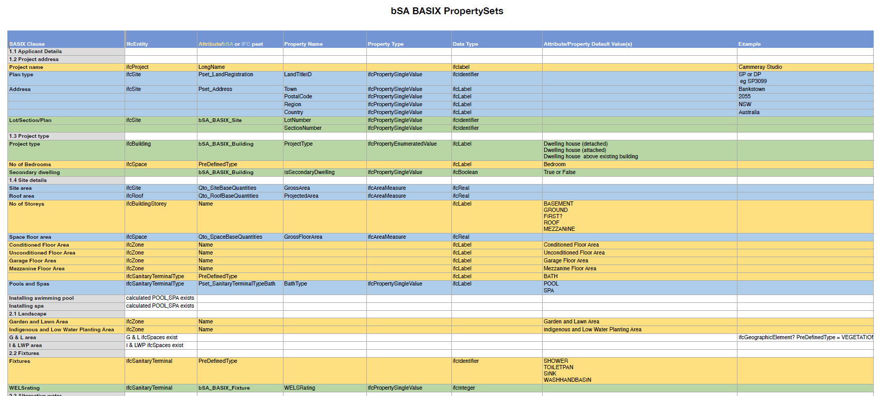
Improving Productivity mapping data for BASIX use
Mapping of BASIX terminology to IFC standard and custom properties and Property Sets

Slide 20
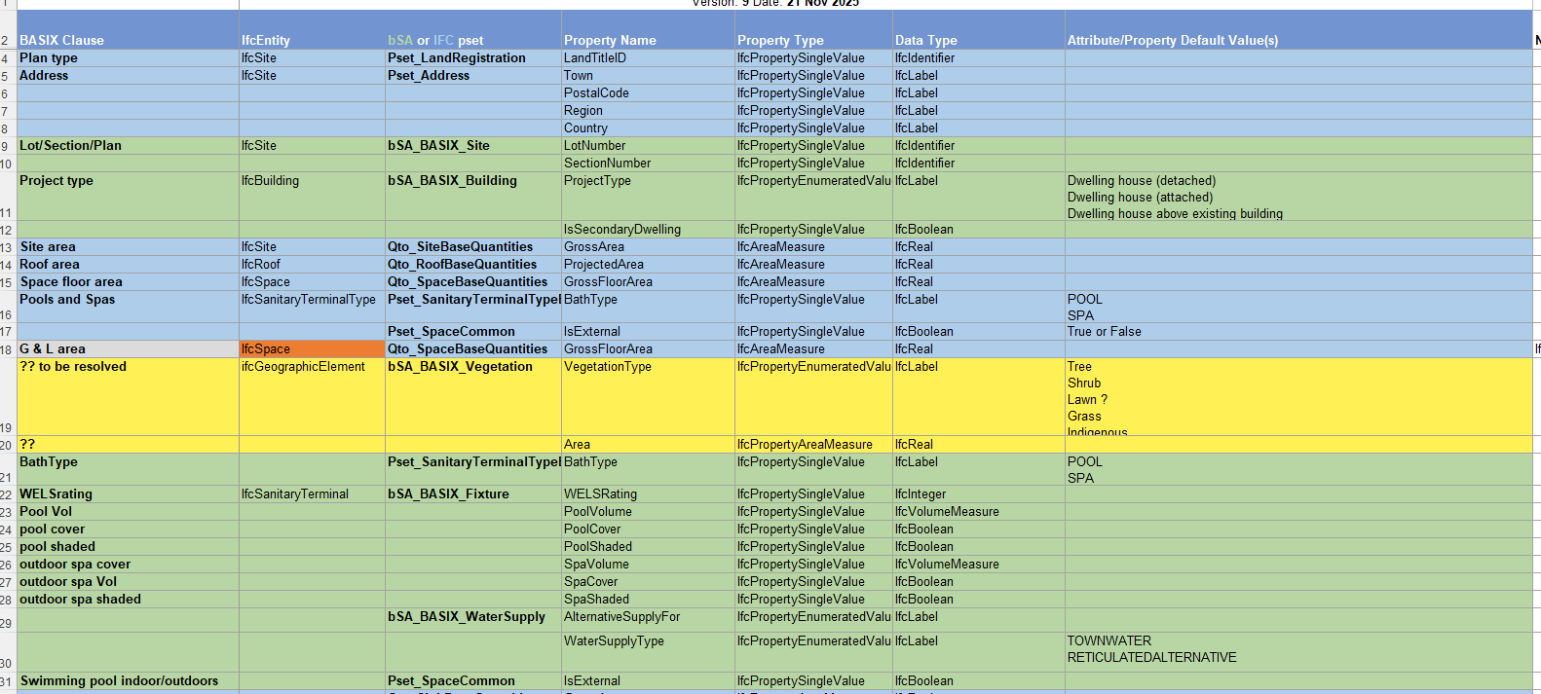
Improving Productivity mapping data for BASIX use
Mapping of BASIX terminology to IFC standard and custom properties and Property Sets

Slide 21
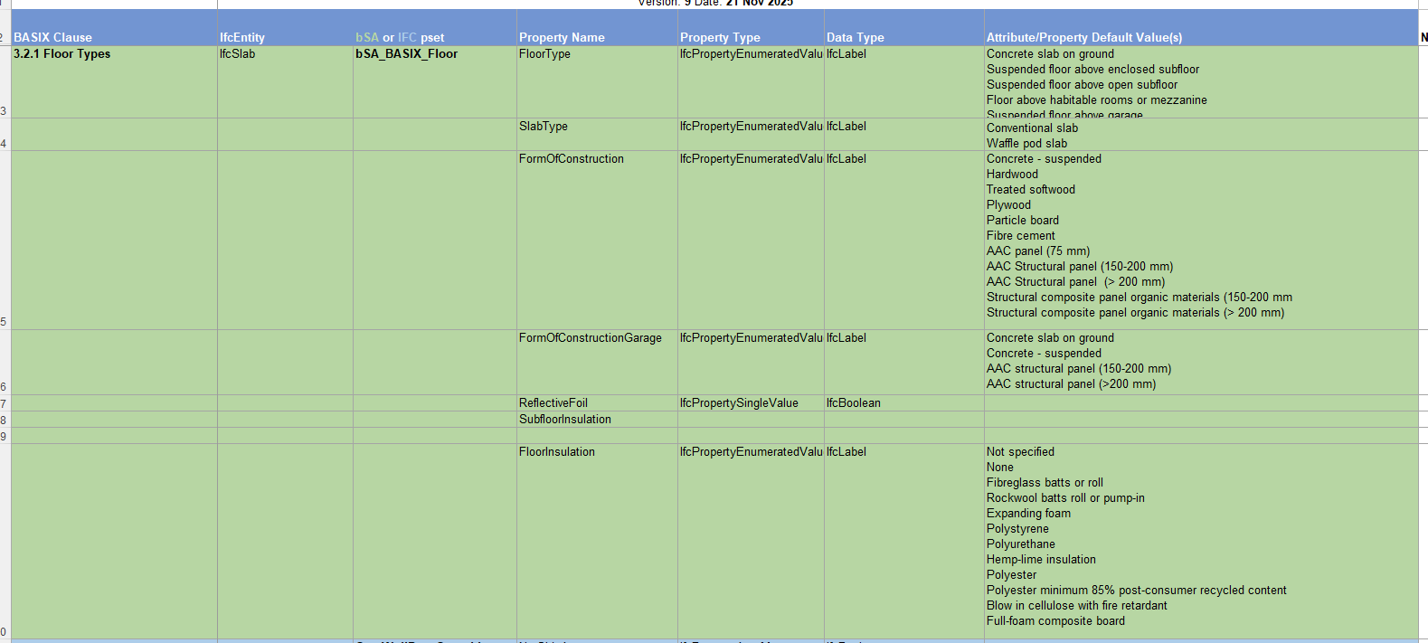
Improving Productivity mapping data for BASIX use
Mapping of BASIX Floor Types terminology to IFC standard and custom properties and Property Sets

Slide 22
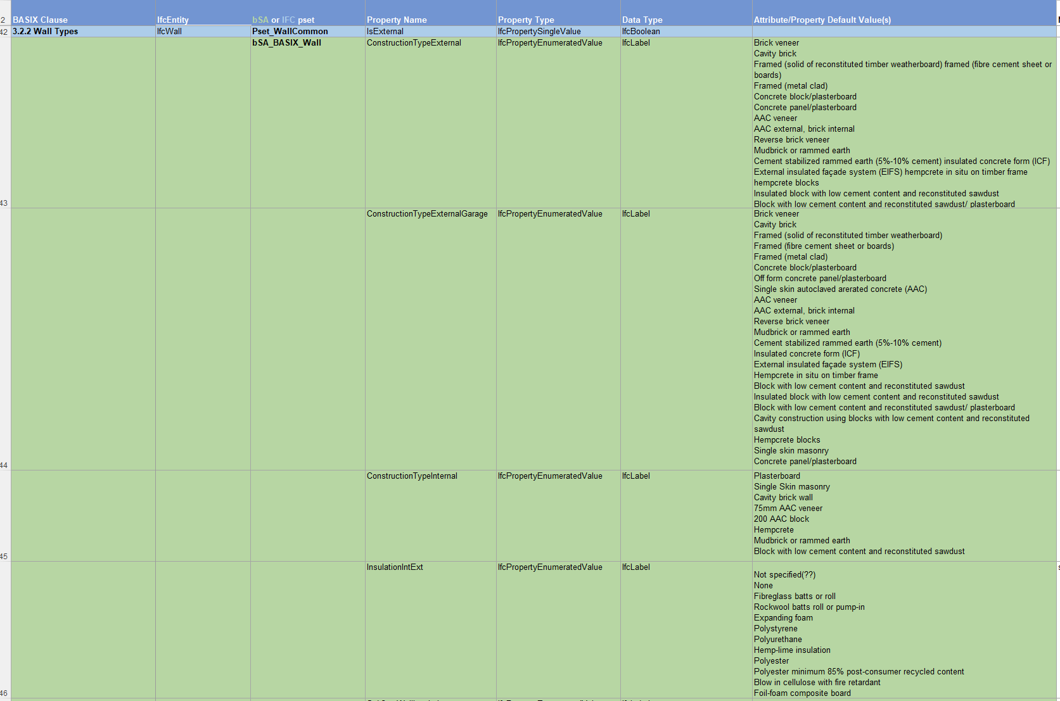
Improving Productivity mapping data for BASIX use
Mapping of BASIX Floor Types terminology to IFC standard and custom properties and Property Sets

Slide 23
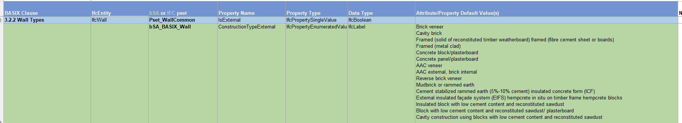

Improving Productivity mapping data for BASIX use
Mapping of BASIX terminology to IFC standard and custom properties and Property Sets

Slide 24
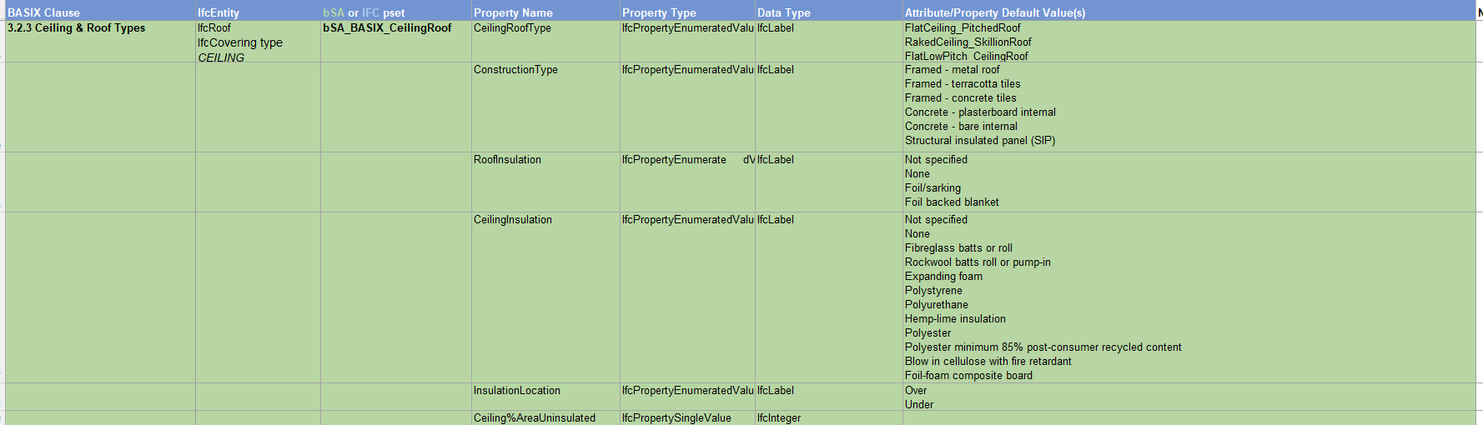
Improving Productivity mapping data for BASIX use
Mapping of BASIX terminology to IFC standard and custom properties and Property Sets

Slide 25
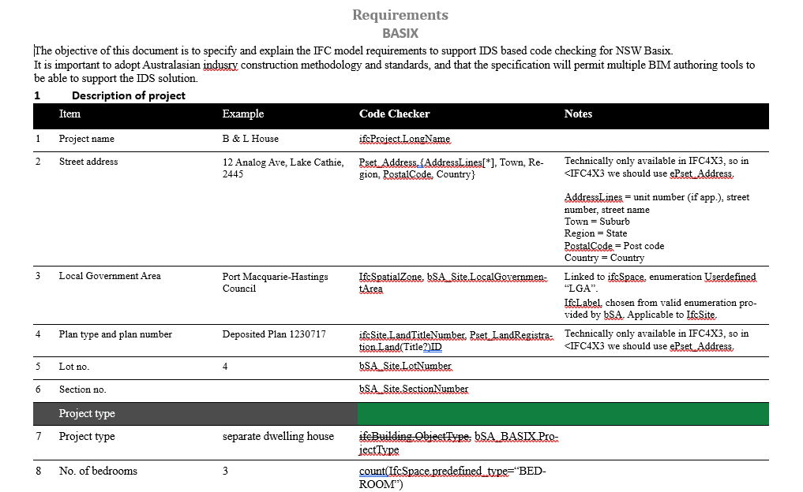

Slide 26
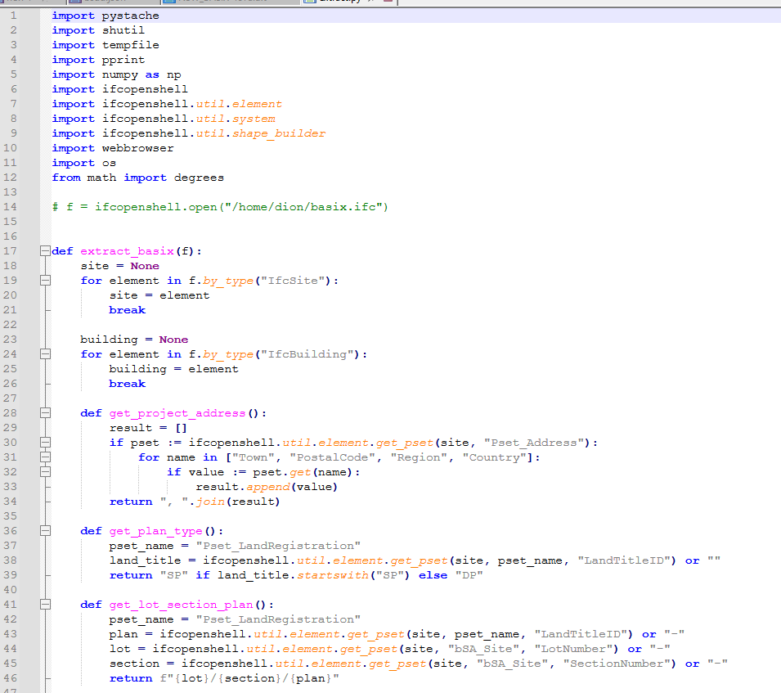
Back end coding

Slide 27
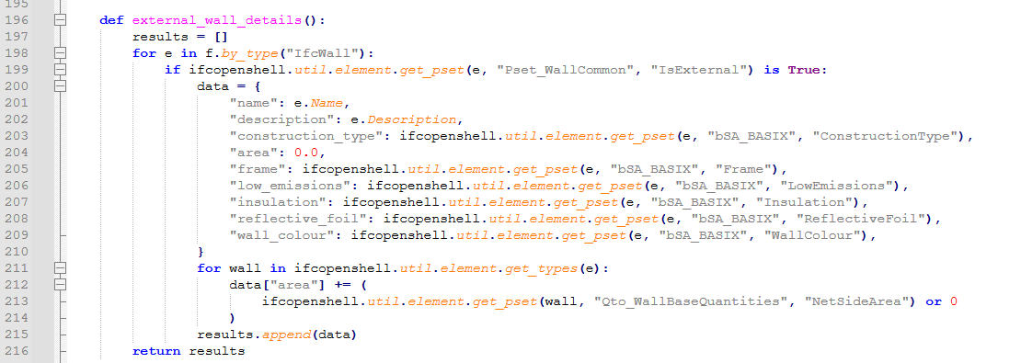
Back end coding

Slide 28
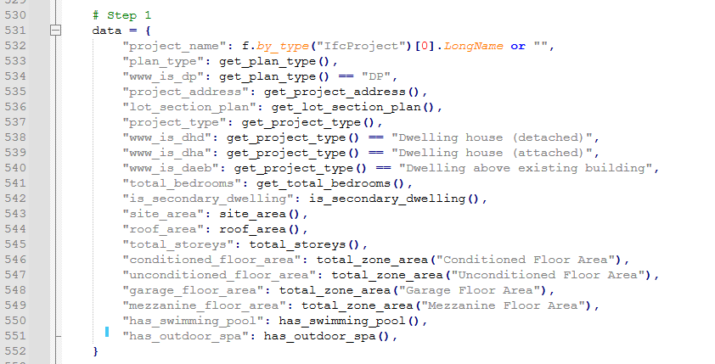
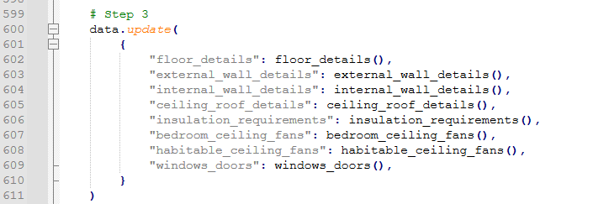
Back end coding

Slide 29
Back end coding

Slide 30
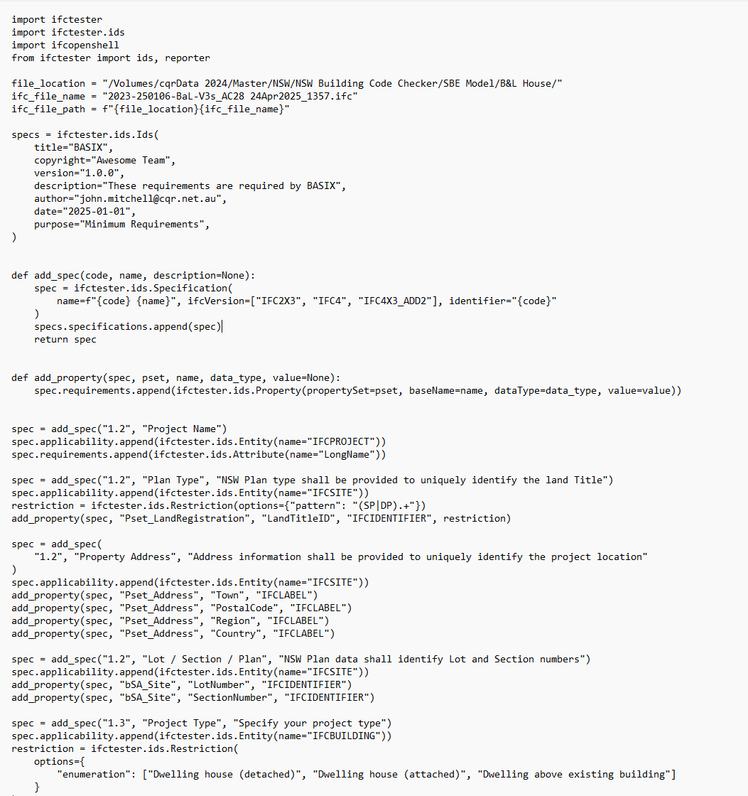
Improving Productivity using IDS

Slide 31
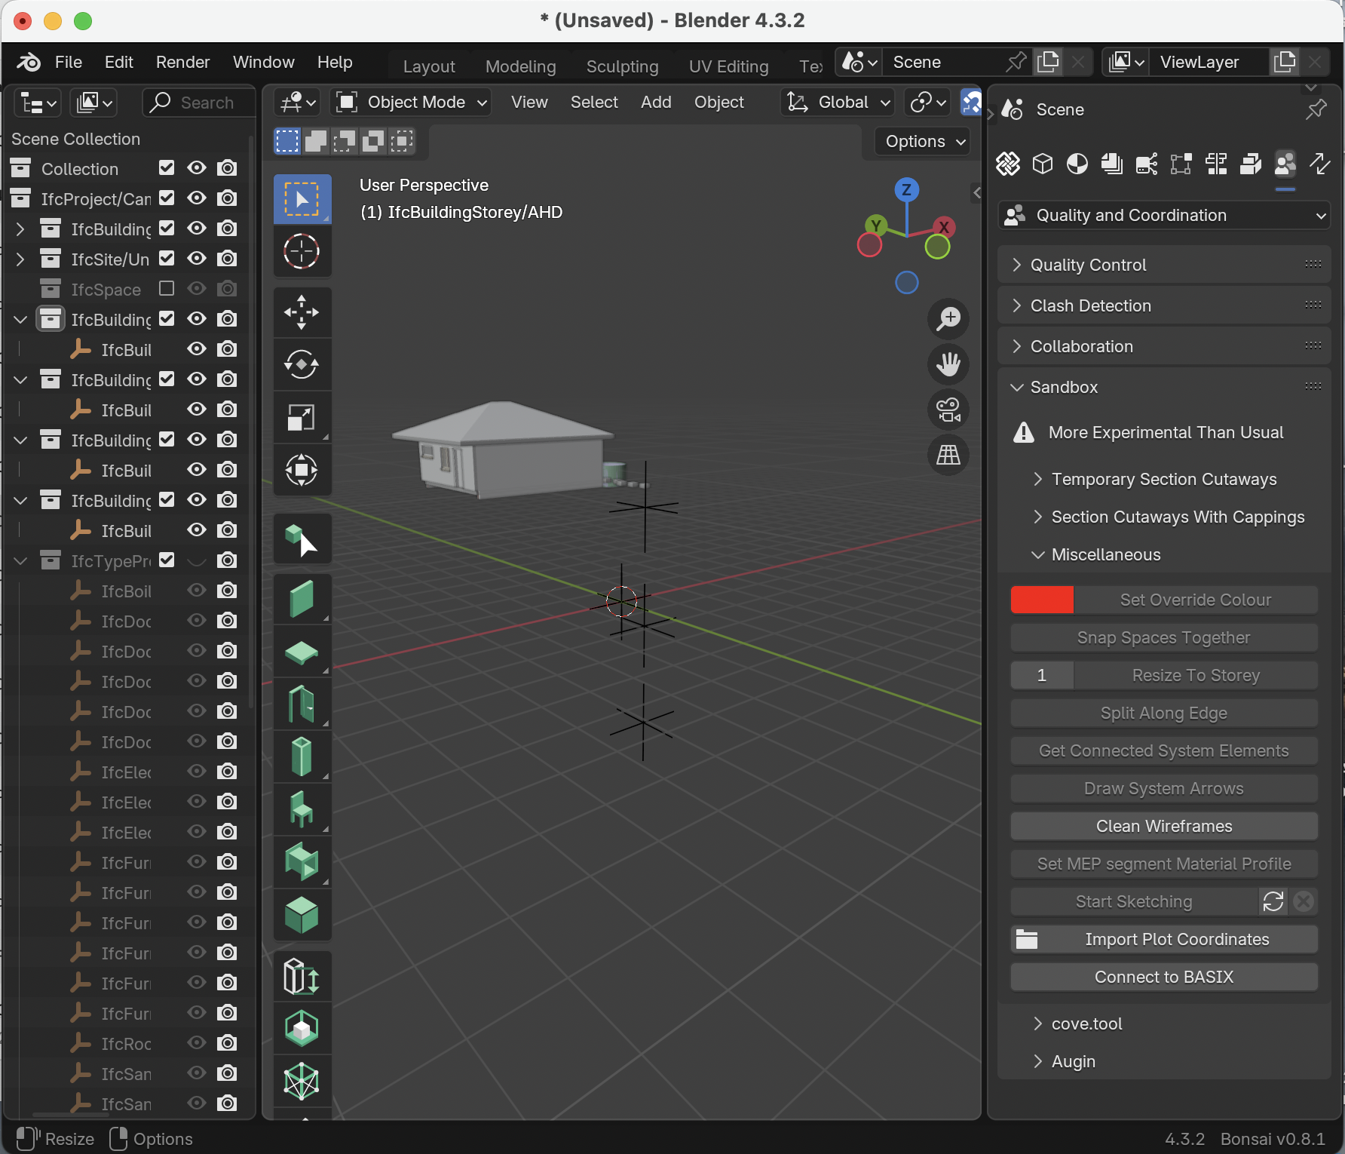
Running the model data extract to BASIX website
BASIX magic

Slide 32
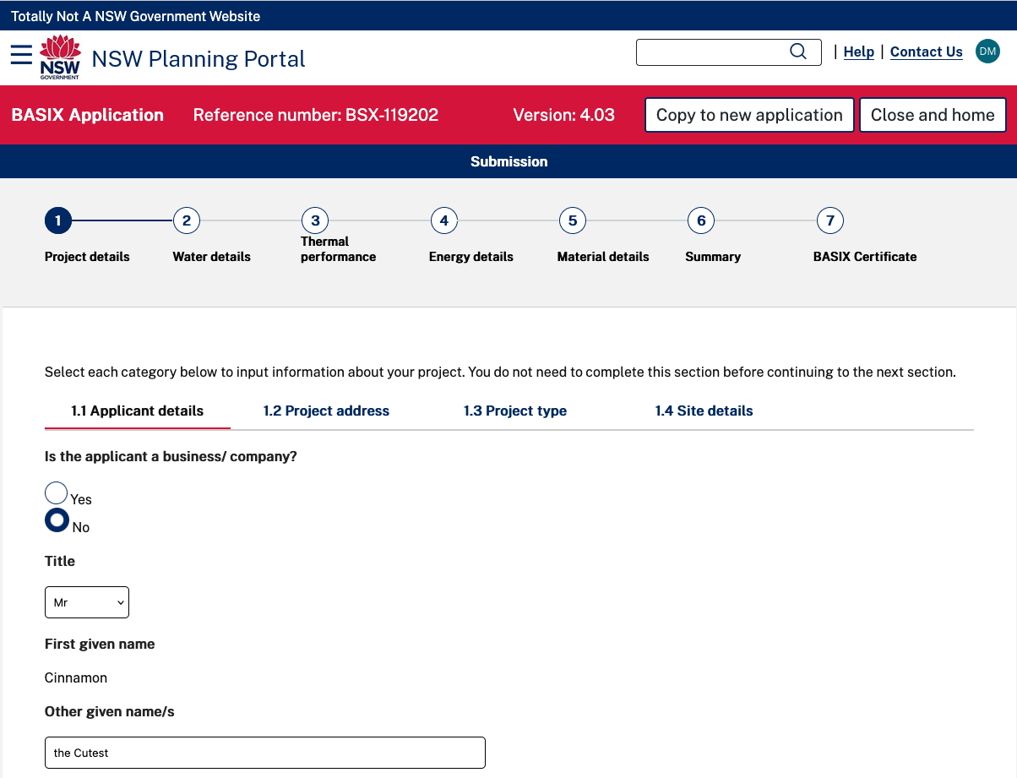

Slide 33
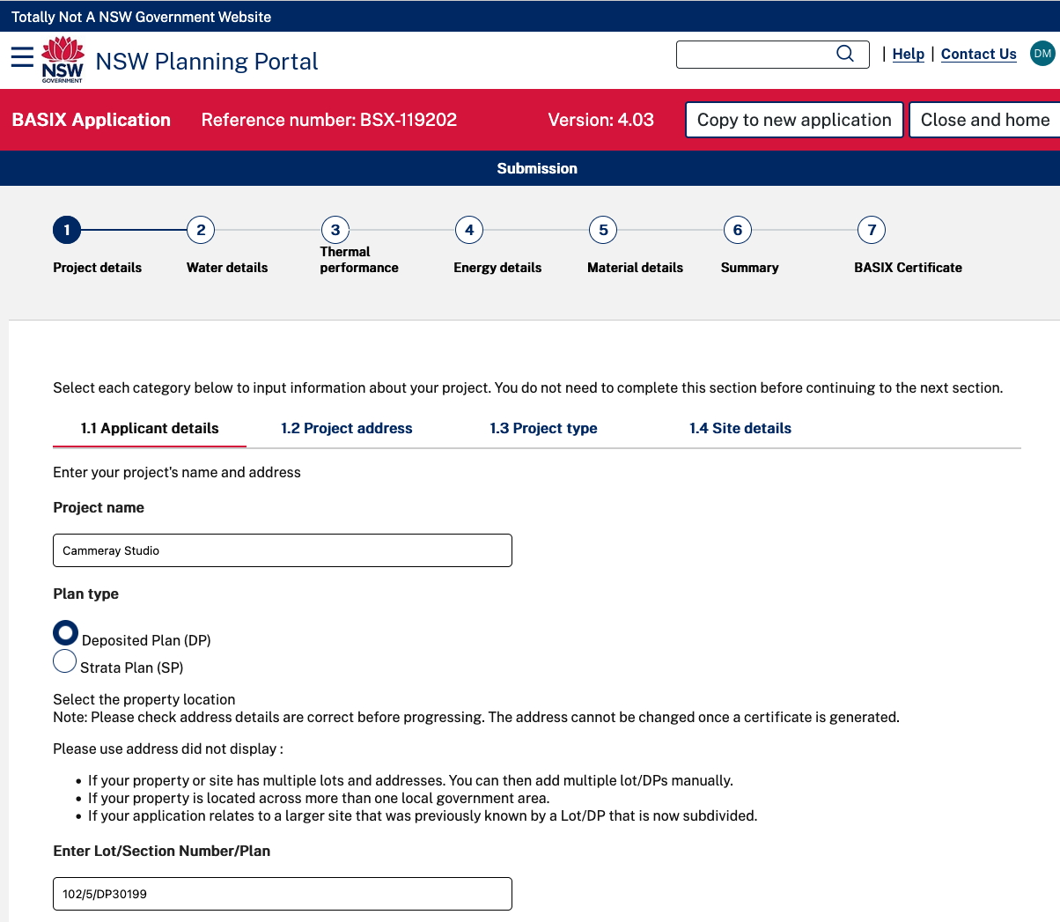

Slide 34
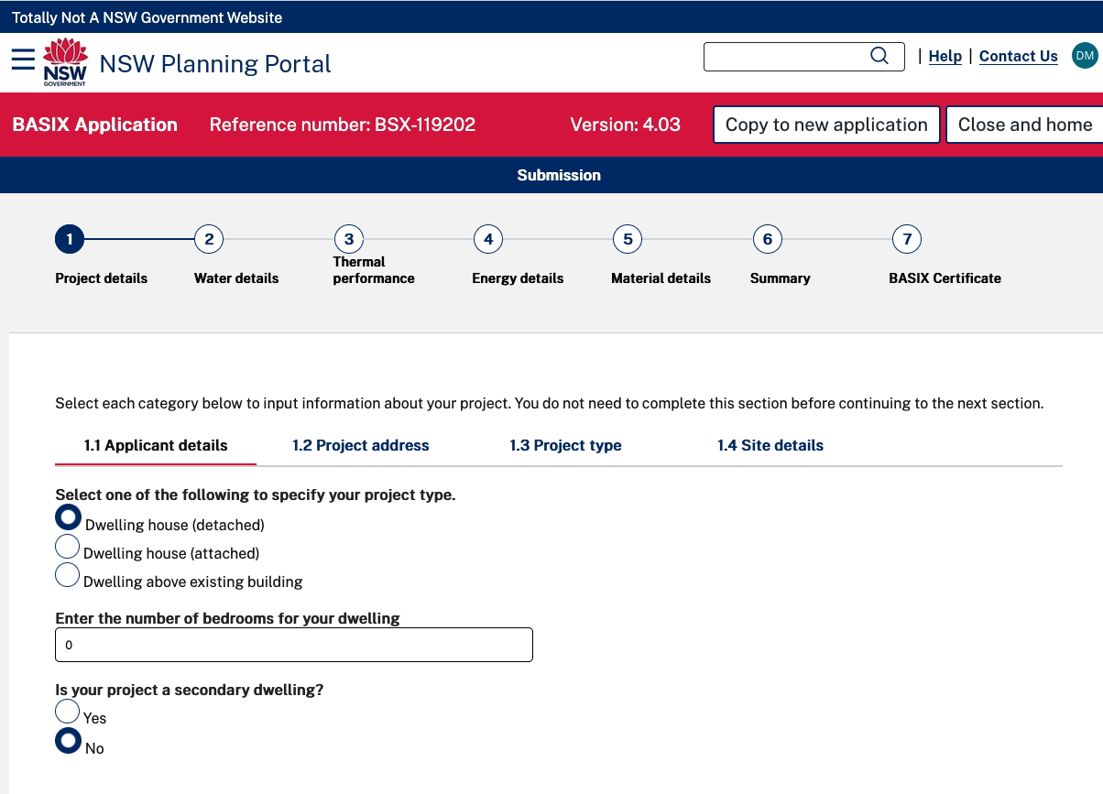

Slide 35
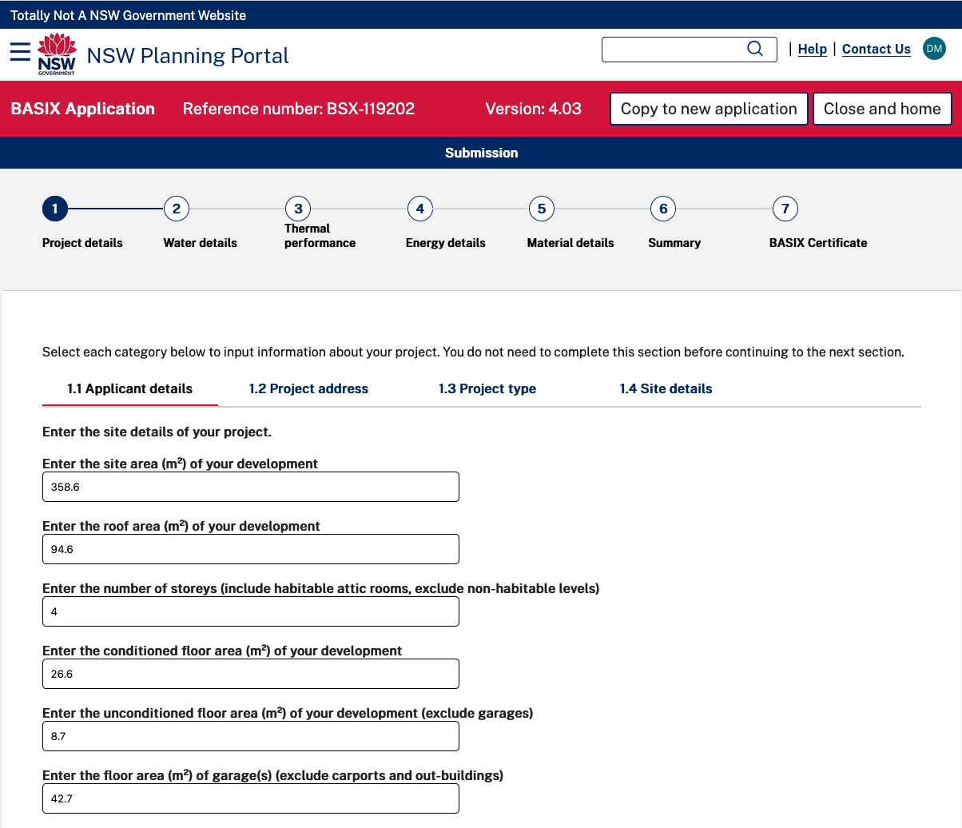

Slide 36
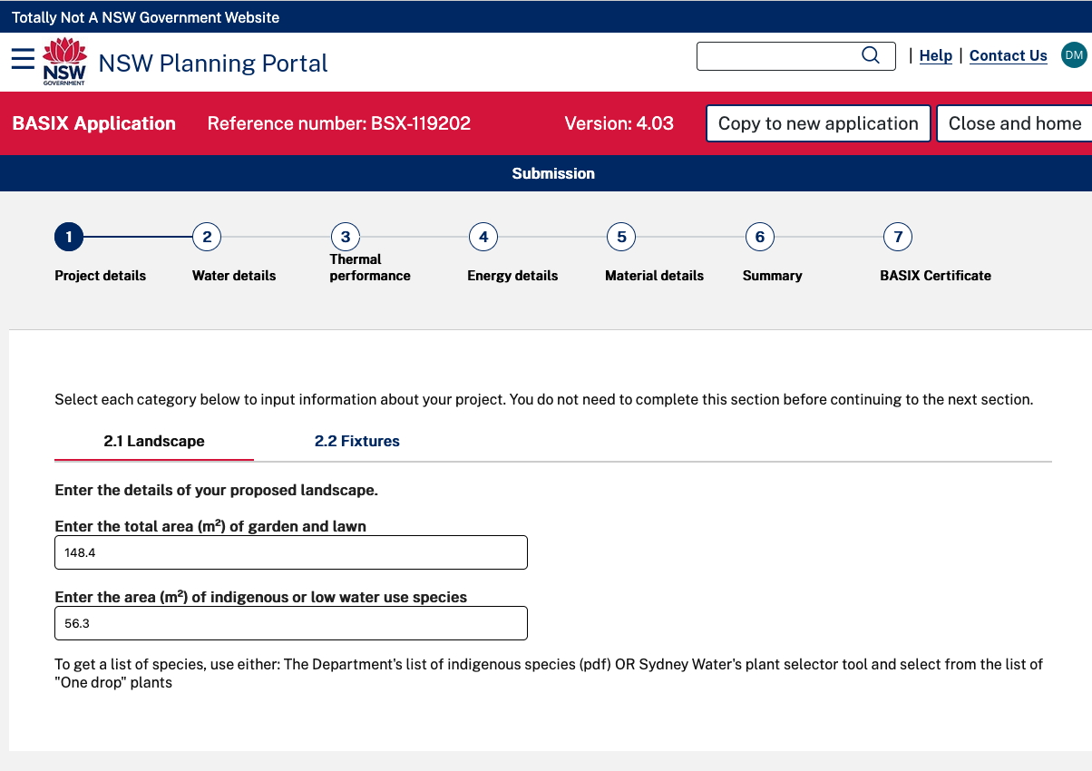

Slide 37
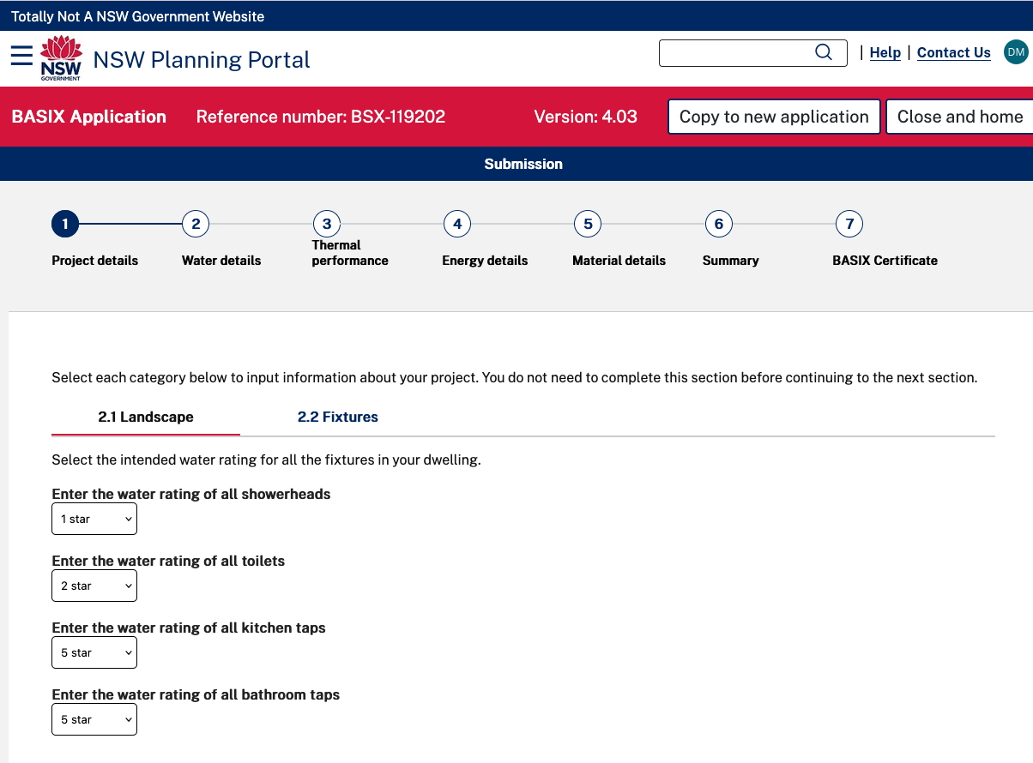

Slide 38
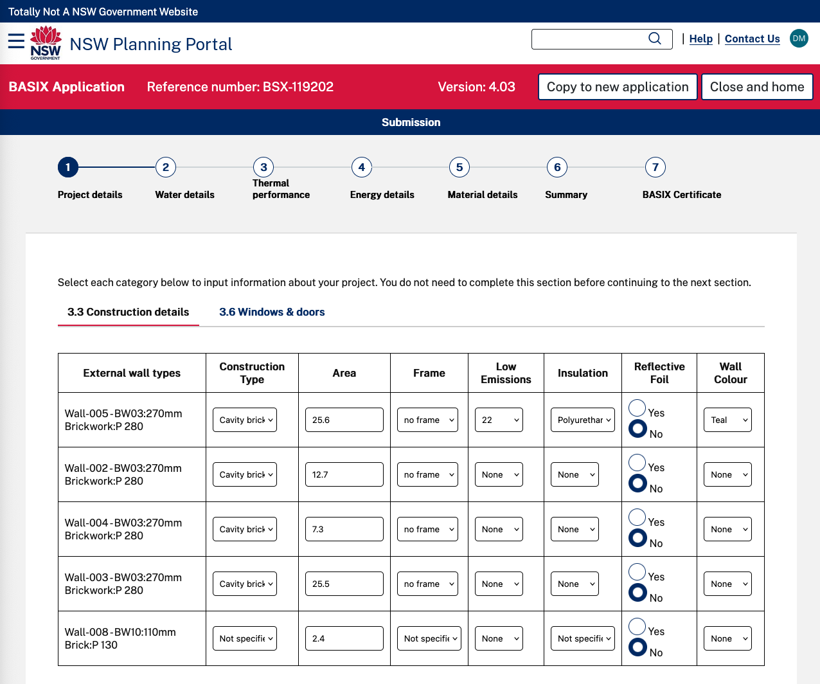

Slide 39
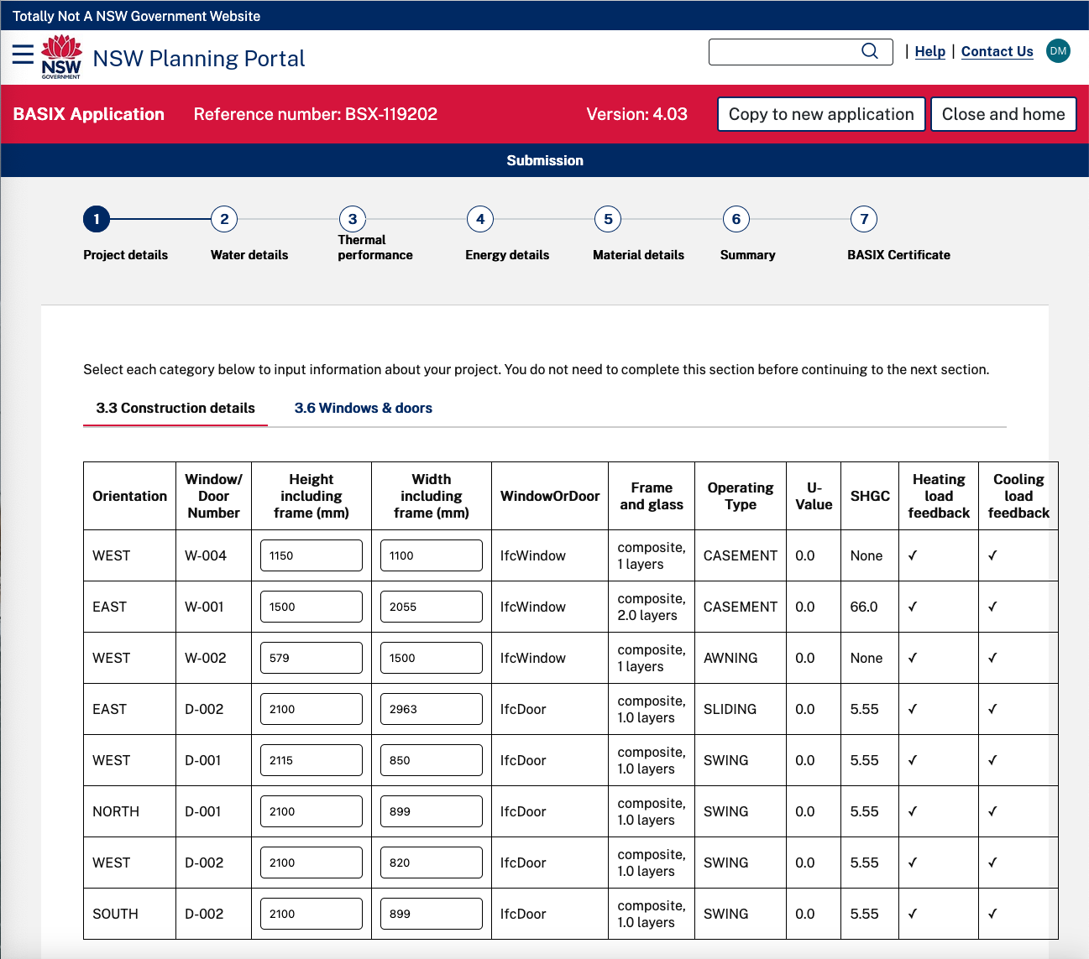

Slide 41
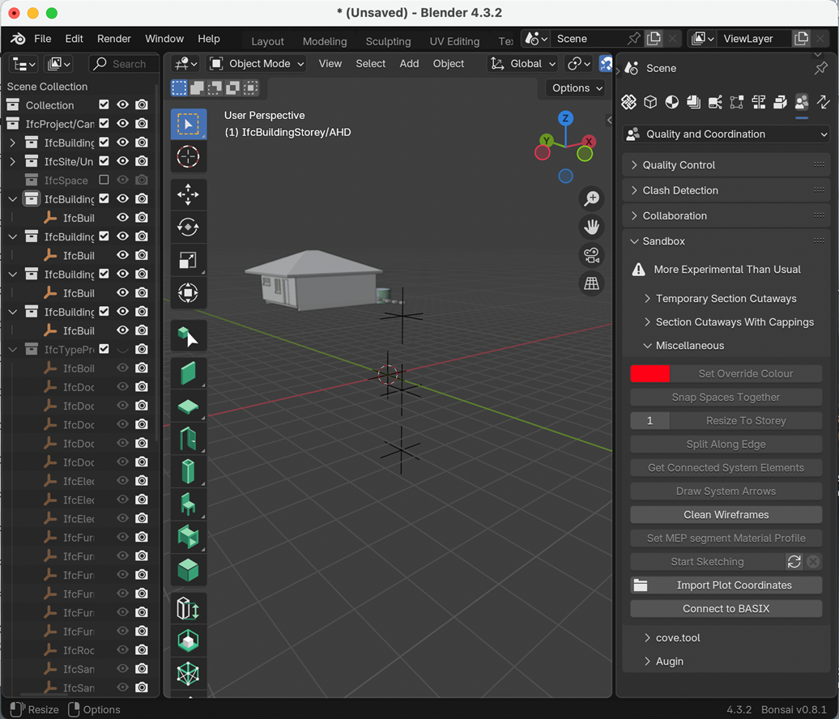

Potential next steps
Seek ABCB, NABERS, BASIX and industry support to invest in a complete solution
We have already a working team, and need government, product manufacturers and industry associations to support the concept as a national initiative
Our prototype highlights the productivity gain to both submitters and assessors as the model becomes a reliable, single source of data required by BASIX.
This project can introduce to Australian building authorities the benefits of model-based code checking adding a further layer of efficiency addressing the current low productivity of the building industry
A bSDD library of BASIX specific terms can be created to support web access and project consistency.

Slide 42
Relevance for code compliance other uses
Adopting the IFC model solution
facilitates incremental submission and testing during design phase
enhances services integration with the architectural models
provides BASIX with precise (geo-referenced) geometric, spatial & performance measures
solution can be expanded for other regulatory compliance
Similarities with DA submission via the internet
Parallel compliance method proposed for digital submission
Aim for 80% of project data to be accessed from the digital model
Some data for manual entry
Digital connections to cost, carbon calculations, asset management also available

Slide 43

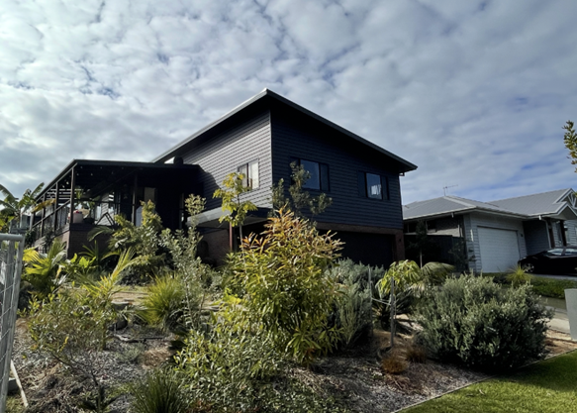
Thank You…..any questions?
Improve Productivity using OpenBIM IFC for BASIX
Online meeting
14th January 2026
John Mitchell: CQR
Scott Beazley: GeometryGym
scott@geometrygym.com
john.mitchell@cqr.net.au

Slide 44
Relevance for other code compliance uses
Parts of the puzzle
Defined data for model and model objects
IDS for machine and human readable briefing
Data added to model
Export to IFC
Verification and validation of model data: Present, valid, correct.
Load into website

Slide 45
Components for creating the Prototype…
Our next steps were to
develop the IDS specification - in prototype - for most of Steps 1 - 3 of the BASIX portal
develop working code (using ifcOpenShell and Python) to generate the web data from the IDS specification
using 2 residential models in Revit and ArchiCAD create test ifc exports using Blender’s IDS reporter, Solibri etc as requirements were specified
As all this came to a point of definition Dion extended his Blender IFC native authoring app to connect the model data to a dummy BASIX web portal

Slide 46
an IDS Specification…
spec = add_spec("1.2", "Project Name”)
spec.applicability.append(ifctester.ids.Entity(name=“IFCPROJECT"))
spec.requirements.append(ifctester.ids.Attribute(name="LongName"))
spec = add_spec("1.2", "Plan Type", "NSW Plan type shall be provided to uniquely identify the land Title")
spec.applicability.append(ifctester.ids.Entity(name="IFCSITE"))
restriction = ifctester.ids.Restriction(options={"pattern": "(SP|DP).+"})
add_property(spec, "Pset_LandRegistration", "LandTitleID", "IFCIDENTIFIER", restriction)
spec = add_spec(
"1.2", "Property Address", "Address information shall be provided to uniquely identify the project location"
)
spec.applicability.append(ifctester.ids.Entity(name="IFCSITE"))
add_property(spec, "Pset_Address", "Town", "IFCLABEL")
add_property(spec, "Pset_Address", "PostalCode", "IFCLABEL")
add_property(spec, "Pset_Address", "Region", "IFCLABEL")
add_property(spec, "Pset_Address", "Country", "IFCLABEL")

Slide 47

an IDS Specification…

Slide 48

getting an IDS report…

Slide 49

Blah, blah, blah
Blah, blah, blah

Slide 50

Blah, blah, blah
Blah, blah, blah

Slide 51

Blah, blah, blah
Blah, blah, blah

Slide 52
Improving Productivity using IDS
As all BASIX submitters know, BASIX requires detailed environmental, water usage, waste, electrical data - the IFC source model needs to be multi-disciplinary!
Our small examples highlight the benefit to modelling requiring authoritative, defensible data in the emerging context of embodied carbon and certified building product data.
Smart digital access to property & land data, council zoning, government utility services, climate zones… would make the model more robust
Adopting the IFC model solution
facilitates incremental submission and testing
enhances services integration with the architectural models
provides BASIX with precise (geo-referenced) geometric, spatial & performance measures
solution can be expanded for other regulatory compliance

Slide 53
Improving Productivity with Open BIM, IFC and IDS
https://evitat.com.au/
https://pp.planningportal.nsw.gov.au/development-and-assessment/basix/about-basix/dwelling-types/multi-dwelling
Multi-dwelling | Planning Portal - Department of Planning and Environment
https://www.planningportal.nsw.gov.au/spatialviewer/#/find-a-property/address
NSW Planning Portal Spatial Viewer

